Slide 1
Predicting User Behavior with AI
Maria Janicka maria.janicka@synerise.com
Barbara Rychalska, PhD barbara.rychalska@synerise.com
Łukasz Sienkiewicz, PhD lukasz.sienkiewicz@synerise.com

Slide 2
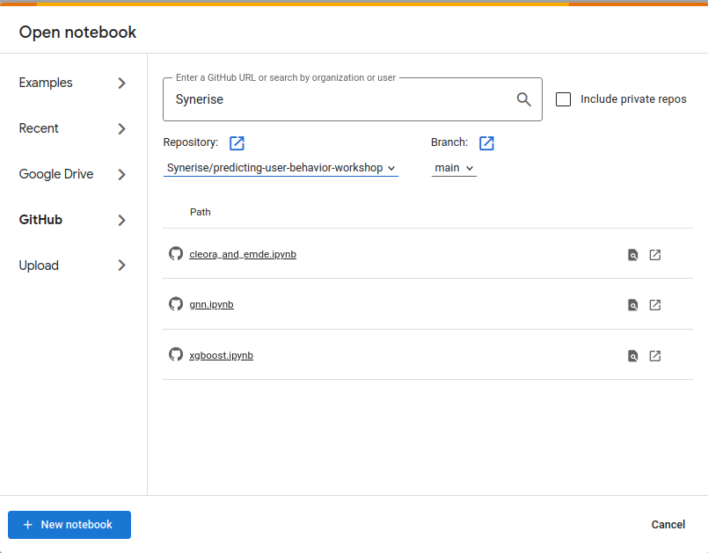
Before we start
Go to https://colab.research.google.com/
Select Open notebook --> GitHub
From Repository drop-down select: Synerise/predicting-user-behavior-workshop
Select XGBoost.ipynb

Slide 3
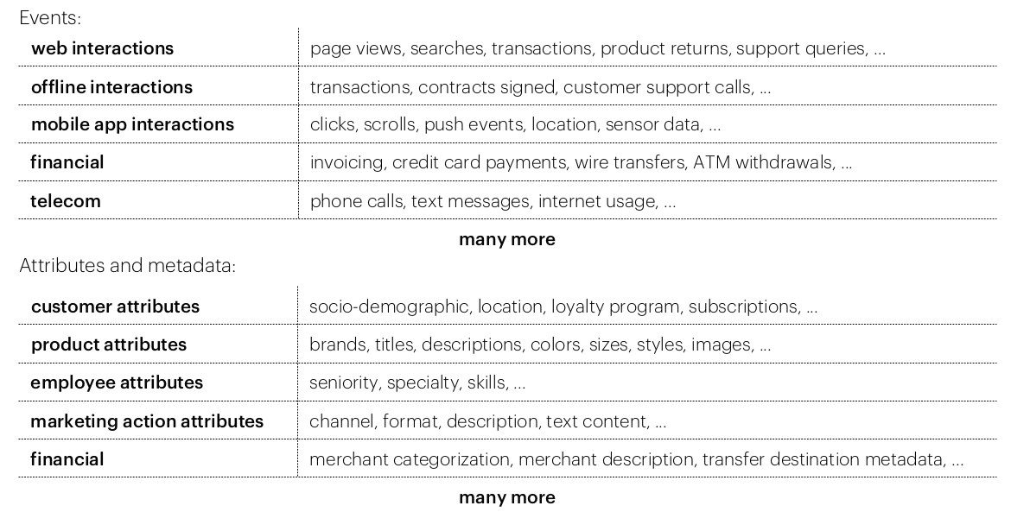
Behavioral Modeling
Predicting future behaviors based on past interactions
Event data — data storing information about user interaction with a service

Slide 4
Behavioral Modeling
Applications:
propensity prediction
churn prediction
recommendations
anomaly detection
customer scoring
customer matching
behavioral hyper-segmentation
and many more...
ML tasks:
binary classification problems
multilabel classification problems
recommendation problems
regression problems
segmentation

Slide 5
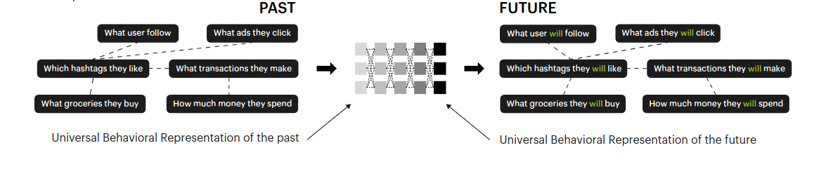
Predicting user future behaviors based on past interactions

Slide 6
User representation methods
Raw event data store various information about products, users, transactions, etc., and how they are interconnected. However, deciding what kind of information may be needed and how to extract them may be a challenge.
Methods:
Hand-crafted features + XGBoost
Graph Neural Networks
Cleora + EMDE

Slide 7
Workshop task
Application: predicting propensity to buy a brand
ML task: multilabel classification
We will train models to predict if a user will buy one of the top 20 selected brands
For each user, we can predict zero, one, or more brands
We will consider one-week time window for the predictions
Business value: this prediction can be used to design targeted campaigns, send personalized newsletters, or creating better-suited offers

Slide 8
Dataset
We create a toy dataset based on Kaggle eCommerce behavior data from multi category store
Each row in the dataset is a single user-product interaction (product buy)
There are three columns: event_time, brand, and user_id
We use data from one month to create model input representations, the next week to create the training target, and the following week for the test target
We drastically reduced the original content of the dataset to fit the time constraints of the workshop

Slide 9
XGBoost
Gradient boosting framework
Trees as a base learners
Regularization techniques to prevent overfitting
Tasks: regression, classification, and ranking

Slide 10
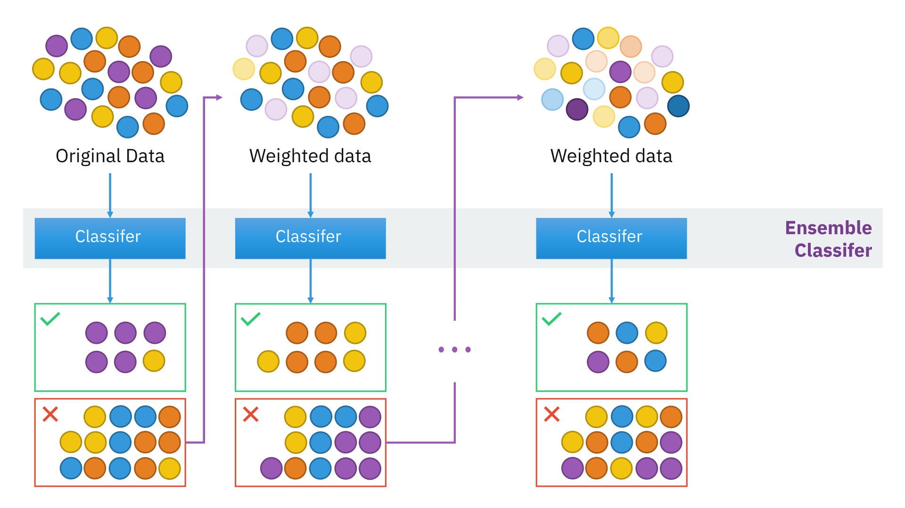
Gradient Boosting algorithm

Slide 11
Evaluation metrics
AUC — area under the ROC (receiver operating characteristic) curve
How well model separate positive classes from negative classes
AUC values:
Perfect classifier = 1
Random results = 0.5
Perfectly wrong classifier = 0
AUC characteristics:
It is scale-invariant
It is invariant to the classification threshold

Slide 12
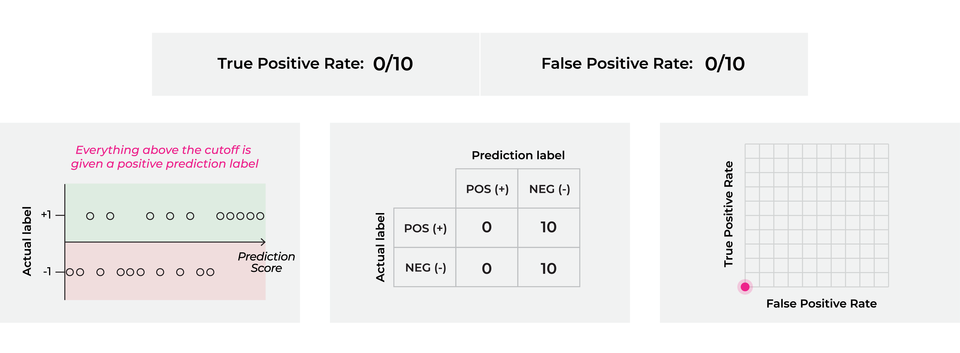
Evaluation metrics — AUC
source: https://arize.com/blog/what-is-auc/

Slide 13

Evaluation metrics — AUC
source: https://arize.com/blog/what-is-auc/

Slide 14
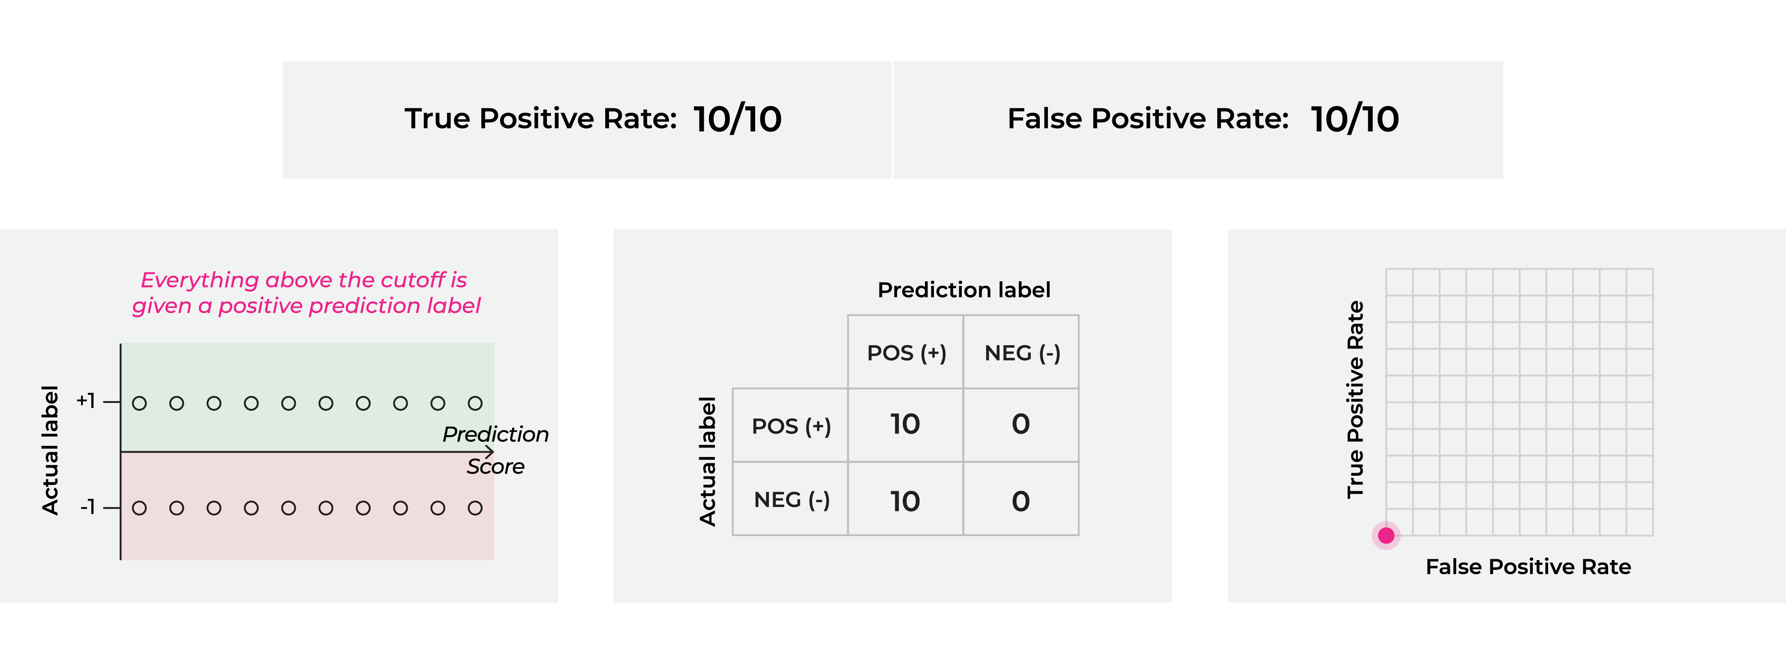
Evaluation metrics — AUC
source: https://arize.com/blog/what-is-auc/

Slide 15
Hand-crafted features advantages and disadvantages
PROS
XGBoost efficiency
Solution simplicity
Good results
CONS
Time required to design features
The limited information value of hand-crafted features
Features need to be pre-computed and stored in a feature stores

Slide 16
Part 2: Graph Neural Networks

Slide 17
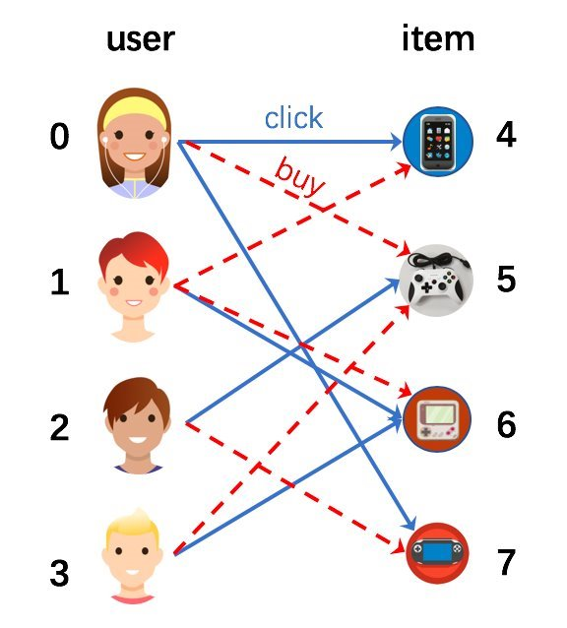
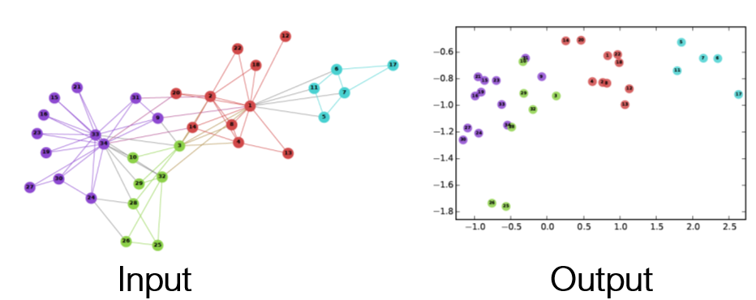
Graphs and Embeddings
The representations encode node similarity
2 nodes are similar if they link to the same nodes
They can also encode node properties
What is a node's degree?
Is it a leaf node?
Etc.
y
x

Slide 18
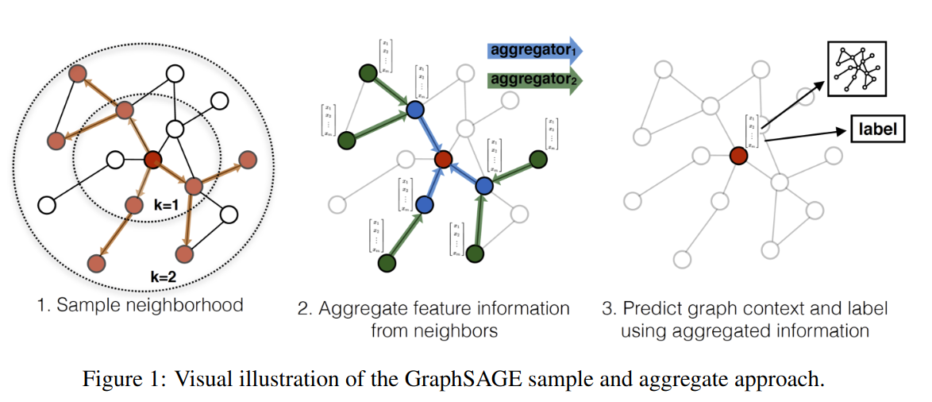
Graph Neural Networks (GNNs)
Hamilton, W., et al. Inductive Representation Learning on Large Graphs https://arxiv.org/pdf/1706.02216.pdf

Slide 19
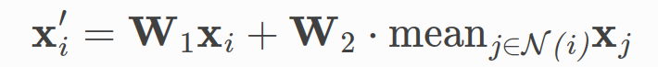
GraphSAGE
New embedding of our node
Old embedding of our node
Mean of the embeddings of all sampled neighbors
Matrix of trainable weights for central node
Matrix of trainable weights for neighbots

Slide 20
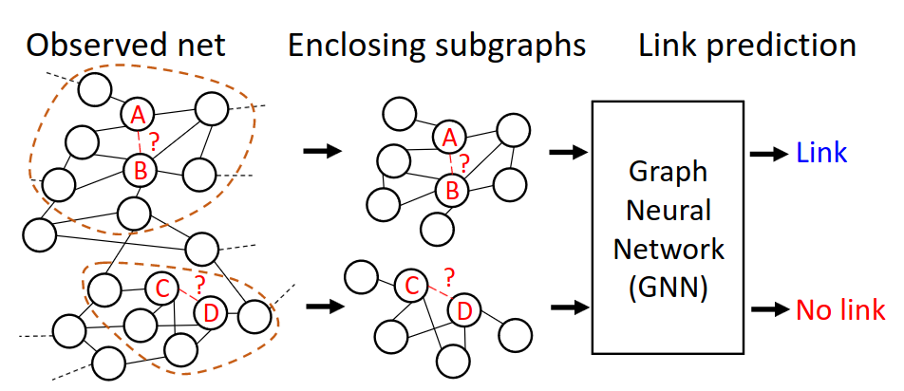
Link Prediction
1
0
Alrahis, L. et al. UNTANGLE: Unlocking Routing and Logic Obfuscation Using Graph Neural Networks-based Link Prediction https://arxiv.org/pdf/2111.07062.pdf

Slide 21
Advantages and Disadvantages
+
-
One of the hottest research directions
Community support – libraries such as PyG and many implementations of papers
No need to manually create any features
Complex architecture
Scalability issues
Neighborhood explosion
May be overcomplex – higher complexity does not necessarily translate into better quality
Dacrema, M., et al. Are We Really Making Much Progress? A Worrying Analysis of Recent Neural Recommendation Approaches https://arxiv.org/abs/1907.06902
Wu, F. et al. Simplifying Graph Convolutional Networks https://arxiv.org/pdf/1902.07153.pdf

Slide 22
Part 3: Cleora and Emde

Slide 23
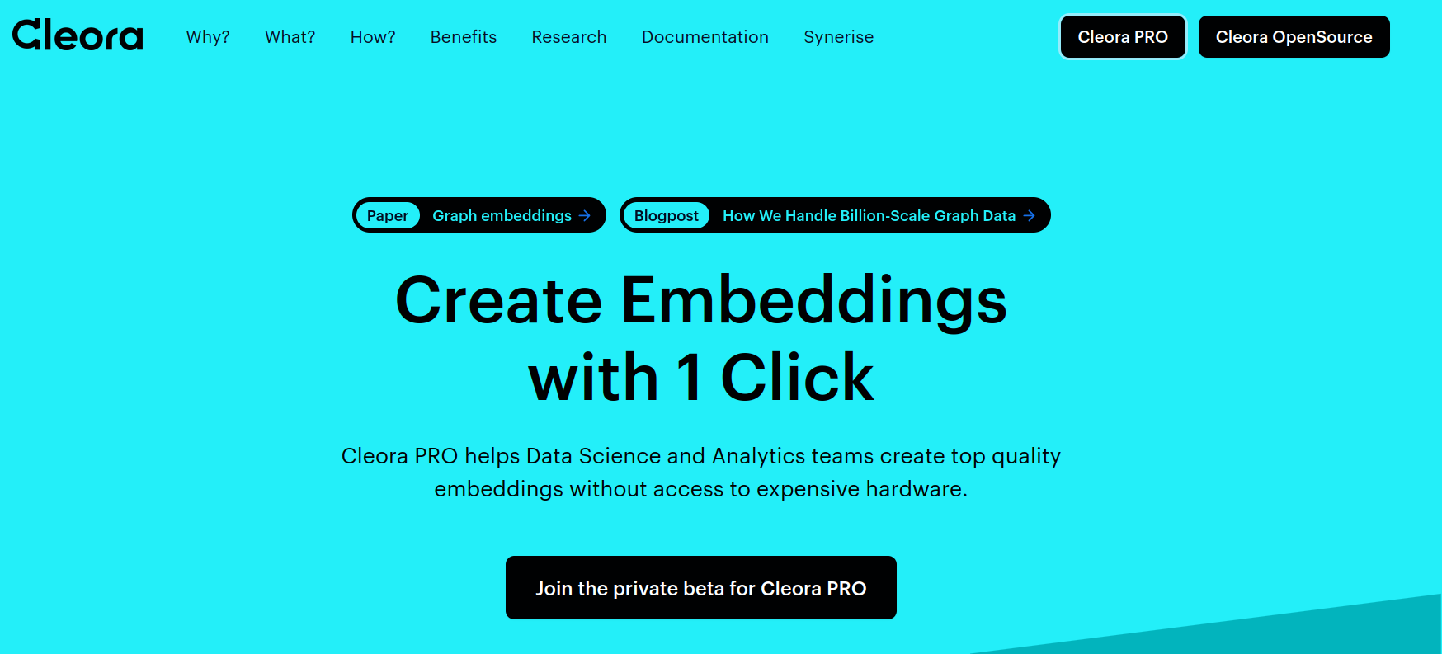
Cleora app with api token
In the following slides we instruct you how to use cleora app with api token.
First you need to type cleora.ai in bar in your web browser and hit enter. You should see the following webpage.

Slide 24
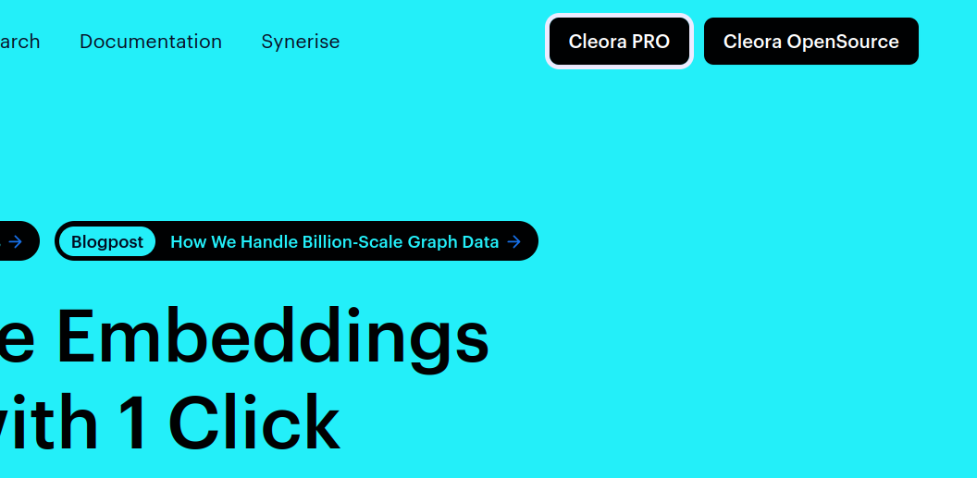
Cleora app with api token
In the top right corner of the webpage you can find Cleora PRO button.
Click on it. You will be redirected to login page.

Slide 25
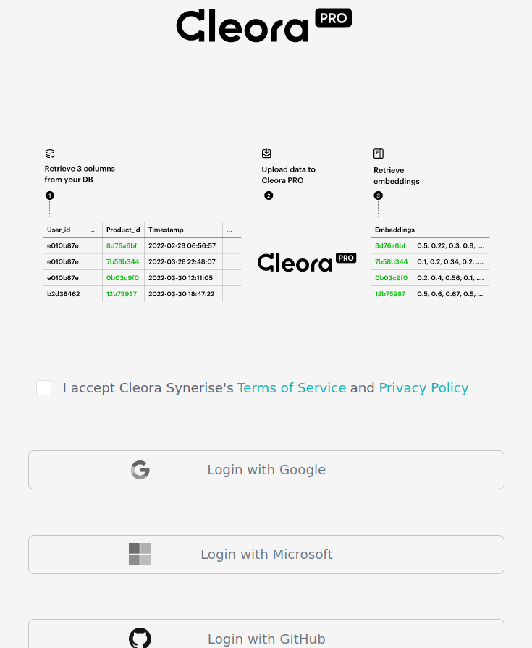
Cleora app with api token
On the login page please read terms and conditions. After accepting you will be able to login using one of the following
Google account
Microsoft account
Github account

Slide 26
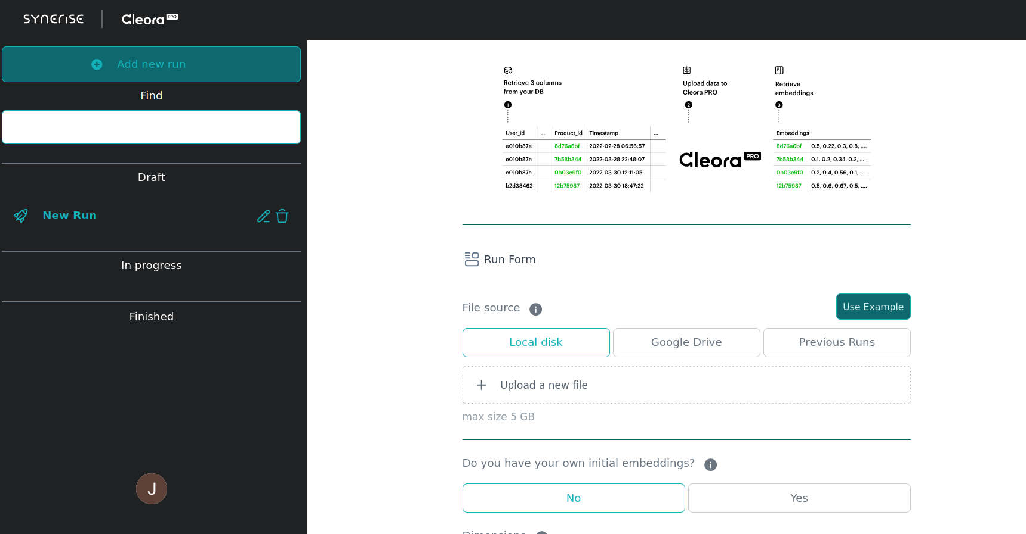
Cleora with api token
After successfully login you will see the following user panel.
Now you have access to cleora. You can upload your data and run cleora in order to produce embeddings. This instruction, however, will explain how to get api token, which can be used from your custom python code or from command line interface.

Slide 27
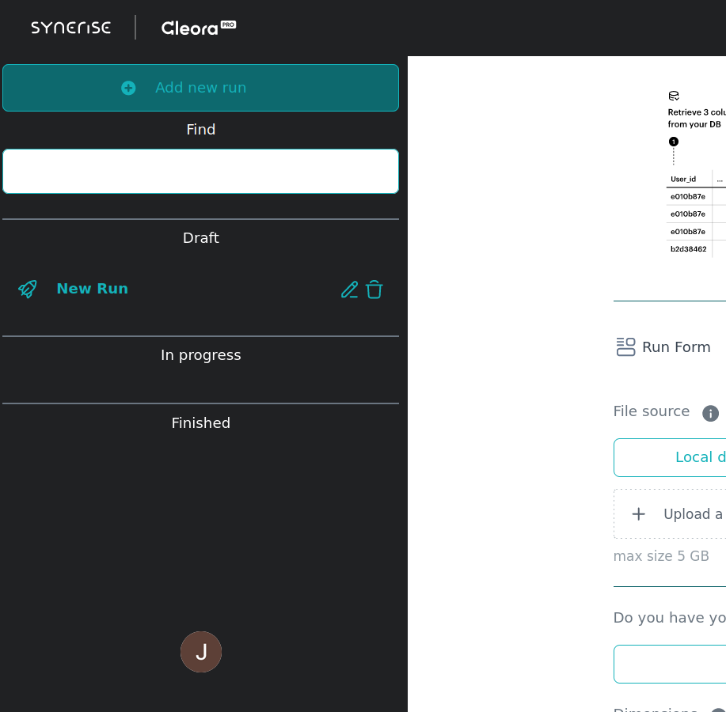
Cleora with api token
To get api token you need to click on your user button in the left bottom corner.
After it clicking small box with user information will open. Right to the Token field you will find widget Copy to clipboard.
After clicking it your token will be copied to clipboard.
Further details are provided in cleora_and_emde.ipynb. Roughly speaking you need to install python package cleora_saas_api with pip. Then you can use your token to access cleora app from your python code.

Slide 28
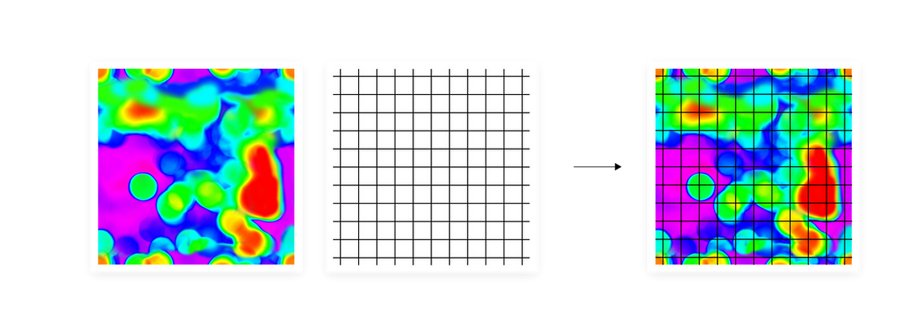
Straightforward approach to estimation of high dimensional data
Suppose that we want to approximate some data on a plane. A straightforward approach would be to use regular square grid. This method, however, is highly inefficient, since regular square grid cannot differentiate between regions with high and low density of data.

Slide 29
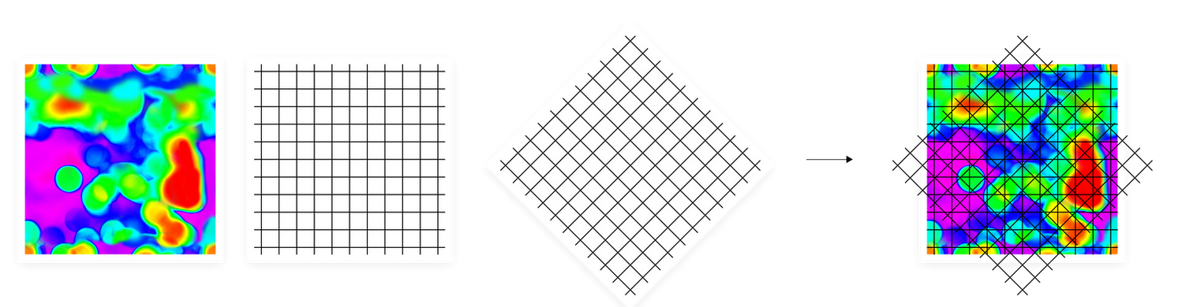
Improvement of the straightforward method
The initial idea with regular square grid can be improved by rotating the grid so that it is better aligned with data.
But with some more effort we can come up with even better idea – instead of using regular grid (rotated or not) we can use irregular grid which fits data very well.

Slide 30
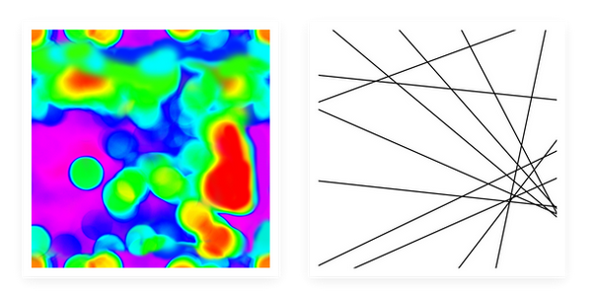
Emde: hyperplane arrangements
First we arrange lines (or hyperplanes in high dimensional case) so that areas (or volumes in high dimensional case) of regions bounded by these lines are inversely proportional to the density of datapoints inside each of them.

Slide 31
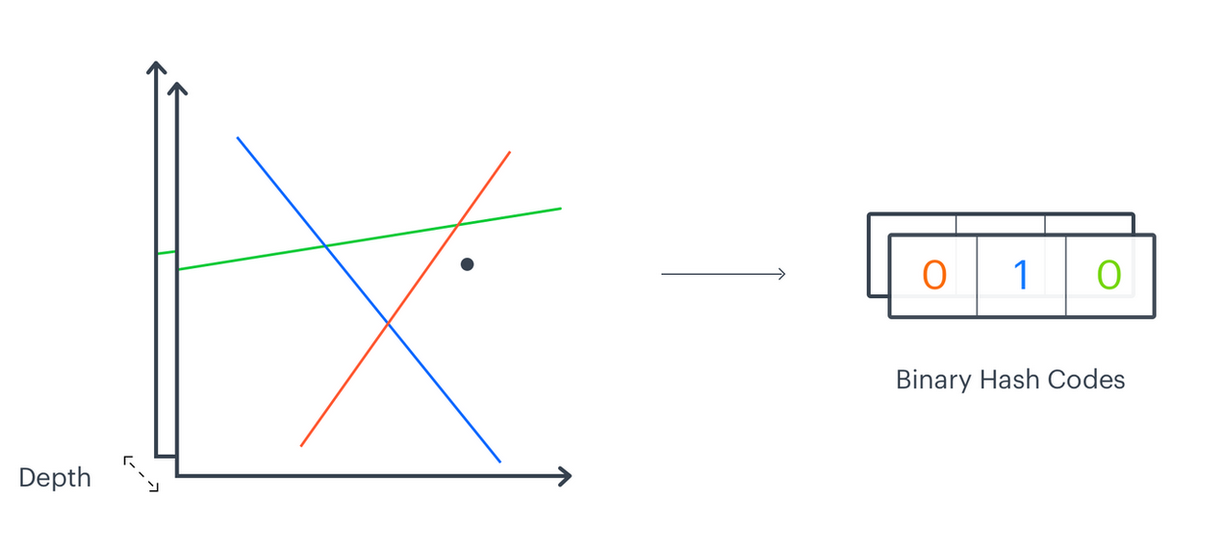
Emde: Depth and binary codes
Moreover, we can construct several independent hyperplane arrangements. We call the number of independent hyperplane arrangements depth. For given datapoint for each hyperplane arrangement we produce binary code, which describes the location of the datapoint in region obtained by the hyperplane arrangement.

Slide 32
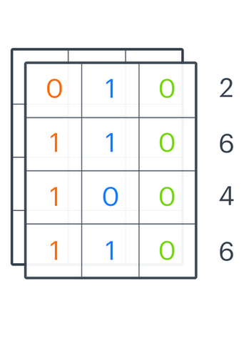
Emde: Producing final codes
Suppose that depth is 4. Then there are 4 independent hyperplane arrangements. Assume that each hyperplane arrangement consists of 3 lines. Then each datapoint gives rise to 4 different binary codes of length 3. Each binary code expresses an integer (in base 2). Thus each datapoint is encoded with 4 integers.
As we explained depth is the number of hyperplane arrangements. This is one of the parameters for Emde. The other is width which is the number of regions in each hyperplane arrangement.

Slide 33




Thank You
Maria Janicka maria.janicka@synerise.com
Barbara Rychalska, PhD barbara.rychalska@synerise.com
Łukasz Sienkiewicz, PhD lukasz.sienkiewicz@synerise.com

